Slide 1
Building a 3-bit Flash-Type A/D Converter Using Operational Amplifiers

Slide 2
GROUP 3
Tanzila Khan
Roll-25
Muhaiminul Islam
Roll-43
Fayek Ahmed
Roll-57

Slide 3
TABLE OF CONTENTS
01
02
03
04
05
06
07
Introduction
Truth Table
Basic
Components
Understanding Flash A/D Converter
Circuit
Diagram
Circuit
Explanation
Conclusions

Slide 4
Introduction
Welcome to our presentation on building a 3-bit Flash-type A/D Converter using Operational Amplifiers (Op Amps). In this presentation, we will guide you through the process of designing and constructing a Flash-type A/D Converter that can convert analog signals into digital ones with high speed and accuracy.

Slide 5
Basic Component
8 pieces of 1k ohm resistors
3 pieces of 470 ohm resistors
2 LM324n Op-Amp ICs
One 8*3 priority encoder
(IC Model: CD74HC147)
3 LEDs

Slide 6
Understanding Flash A/D Converter
Speed: Flash ADCs are fast, providing one output code per clock cycle.
Accuracy: Achieving high accuracy requires matching the performance of all comparators.
Power: Flash ADCs consume significant power due to simultaneous operation of all comparators.
Cost: Implementing flash ADCs becomes expensive for higher resolutions.
Trade-offs: Consider speed vs. resolution, power vs. accuracy, and component count vs. cost when designing a flash ADC .

Slide 7
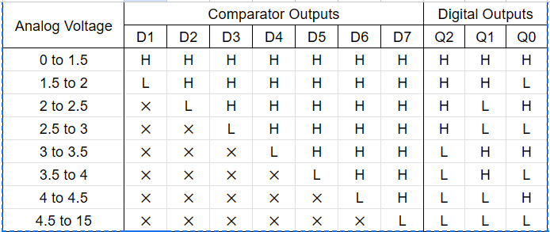
Truth Table
Below Truth Table of 3-bit Flash ADC is Provided:

Slide 8
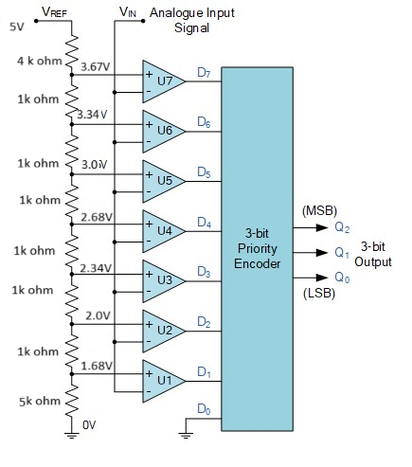
Circuit Diagram of 3-bit Flash A/D converter
1. Operational Amplifiers (Op-Amps):
The op-amps serve as the primary signal conditioning elements in the circuit.
They amplify and shape the analog input signal before it is compared to reference voltages by the comparators.
2. Comparators:
Connected to the outputs of the op-amps, comparators compare the amplified analog signal with a set of reference voltages.
The number of comparators determines the resolution of the A/D Converter.
3. Voltage Reference:
The voltage reference circuit generates stable and precise reference voltages required for accurate A/D conversion.
This circuit ensures consistency and linearity in the conversion process.
4. Flash Encoder:
The flash encoder circuit receives the outputs of the comparators and encodes them into a binary digital output.
It determines which comparators have their inputs above or below their respective reference voltages, thereby generating the digital representation of the input signal's magnitude.

Slide 9
Circuit Explanation
Operational Amplifiers:
At the heart of our A/D Converter are operational amplifiers (op-amps), which play a crucial role in amplifying and conditioning the analog input signal. The op-amp circuitry is designed to provide high gain and low output impedance, ensuring accurate signal processing throughout the conversion process.
Comparators:
Connected to each output of the operational amplifiers are comparators, which compare the amplified analog input signal with a set of reference voltages. These reference voltages are generated by the voltage reference circuit and represent the decision thresholds for each bit of the digital output.
Voltage Reference:
The voltage reference circuit generates stable and precise reference voltages required for the comparators' operation. It is essential for maintaining the accuracy and linearity of the A/D conversion process. Common voltage reference circuits include zener diode-based references or precision voltage regulators.

Slide 10
Circuit Explanation
Flash Encoder:
The outputs of the comparators are fed into a priority encoder circuit, which converts the analog input signal into a binary digital output. The priority encoder essentially determines which comparators have their inputs above or below their respective reference voltages, thus producing the digital output representing the input signal's magnitude.
Signal Flow:
The signal flow through the A/D Converter starts with the analog input signal being amplified and conditioned by the operational amplifiers. The amplified signal is then compared with the reference voltages by the comparators, and the resulting outputs are encoded into a binary digital representation by the flash encoder circuit.
Overall Functionality:
By integrating these components into a cohesive circuit design, we create a high-speed, high-accuracy A/D Converter capable of converting analog signals into digital representations efficiently. Each component's precise operation ensures that the digital output accurately reflects the input signal's magnitude, making our A/D Converter suitable for a wide range of applications.

Slide 11
Conclusion
In conclusion, the development of our 3-bit Flash-Type A/D Converter represents a significant advancement in analog-to-digital conversion technology. By combining theoretical knowledge with practical implementation considerations, we have demonstrated a robust and efficient solution for converting analog signals into digital representations. We look forward to further advancements and applications of A/D Converter technology in diverse fields, contributing to innovation and progress in the digital era.

Slide 12
THANK YOU!

